Slide 1


Employee Management System
Team: SAZAM

Slide 2
Team SAZAM
Sandeep Naik : 300366
Akshay Chavan : 300360
Mohammed Zabiulla : 300372
Arpita Sarvi : 300367
Mayuresh Shivravdekar : 300370
Instructor : Saravanan R

Slide 3
Description
Employee Management System is a software that helps in managing the information of employees in the company.
Project Environment
OS: Windows
Database: Oracle
Programming Language: J2EE, HTML, CSS.

Slide 4
Product Features
Sign Up
Login
Session Management
Add Employee
View Employee
Search Employee
Logout
Mobile Friendly

Slide 5
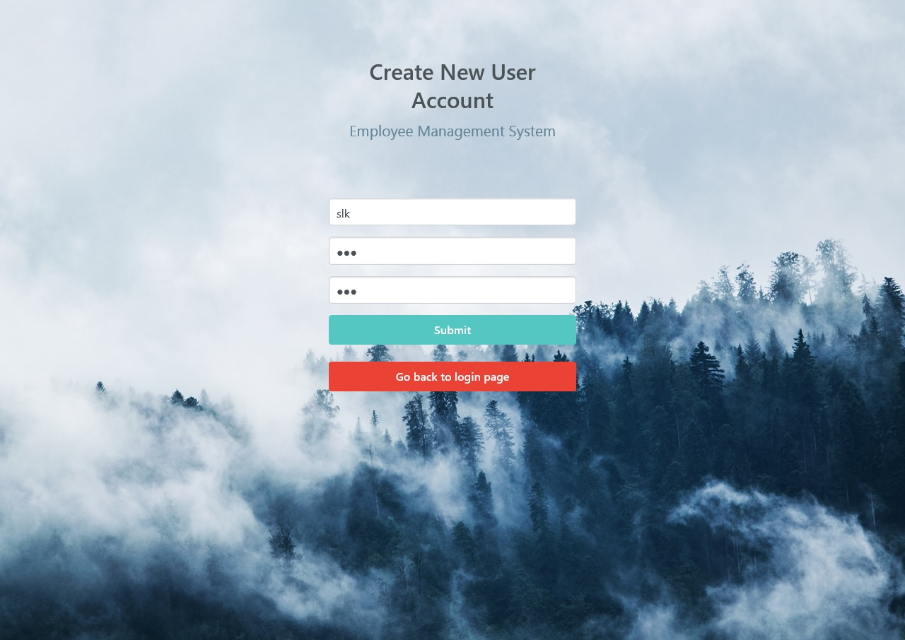
Sign Up

Slide 6
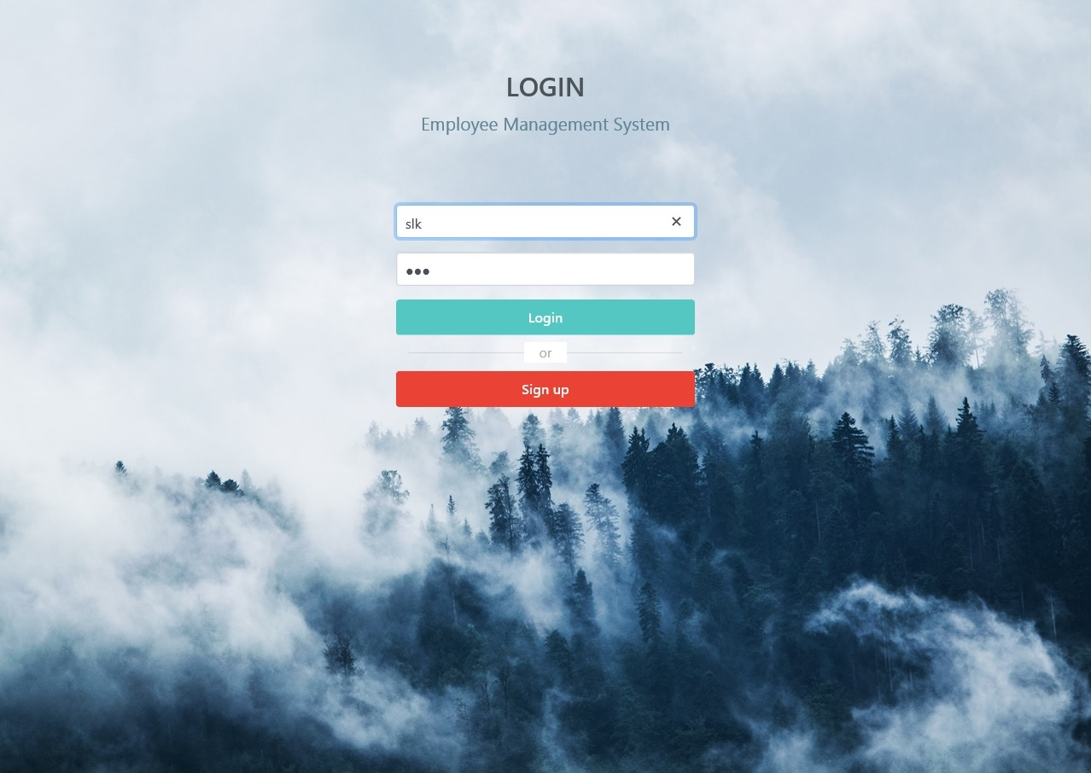
Login

Slide 7
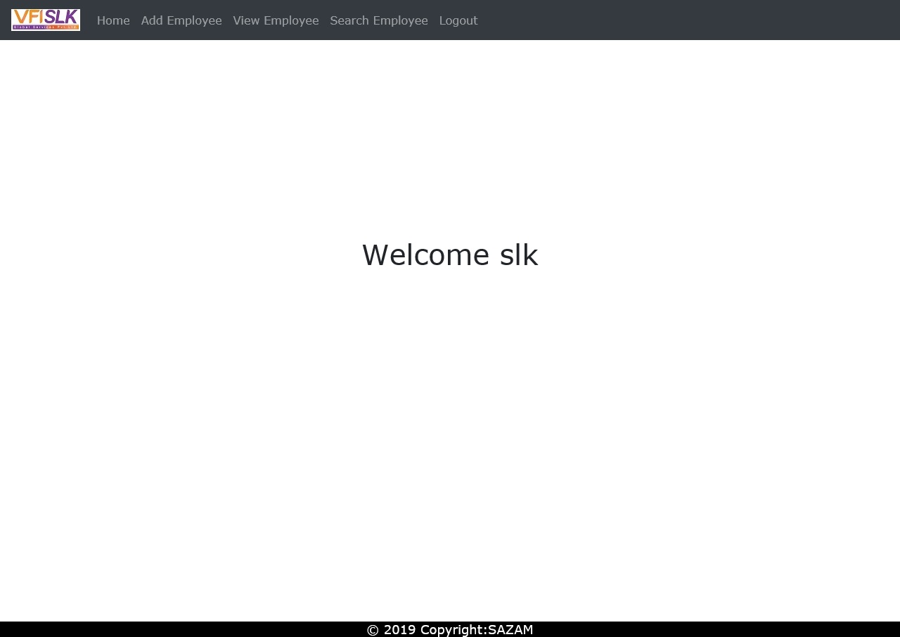
Home Page

Slide 8
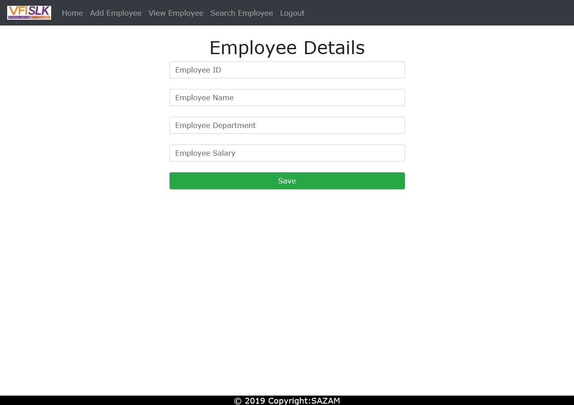
Add Employee

Slide 9
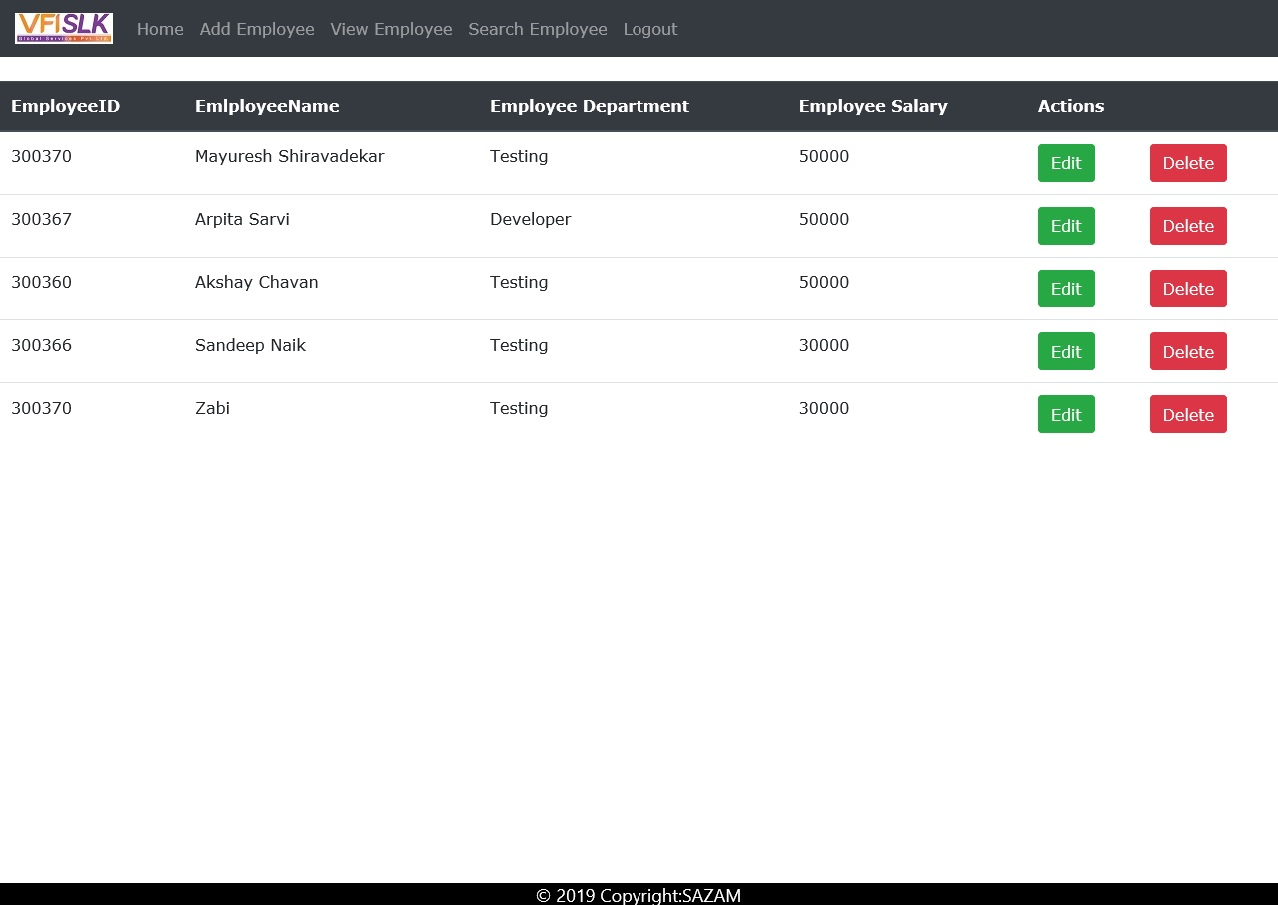
View Employee

Slide 10
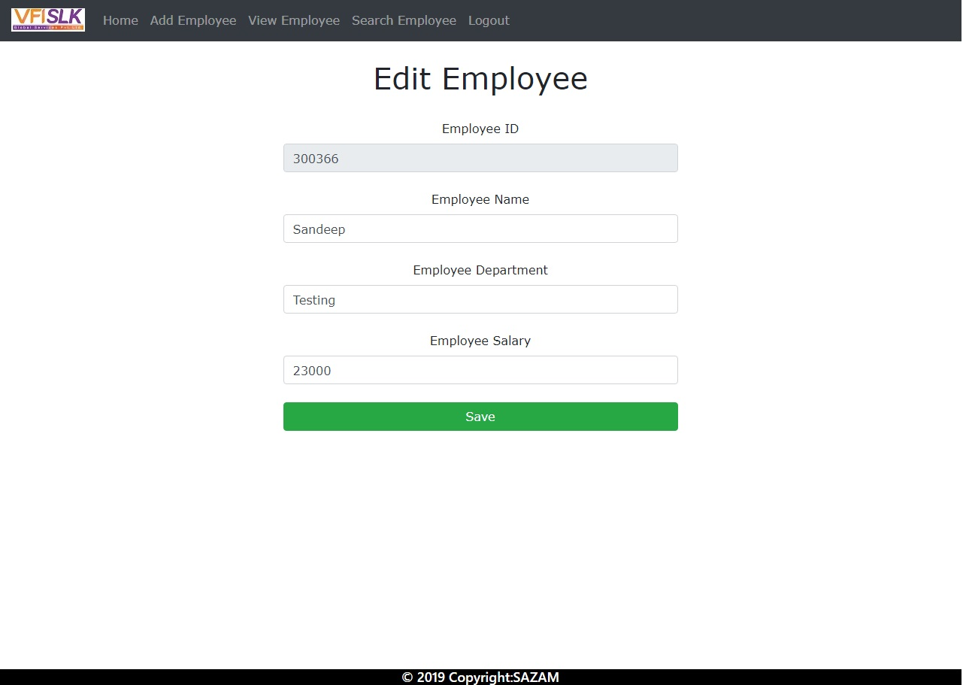
Edit Employee

Slide 11
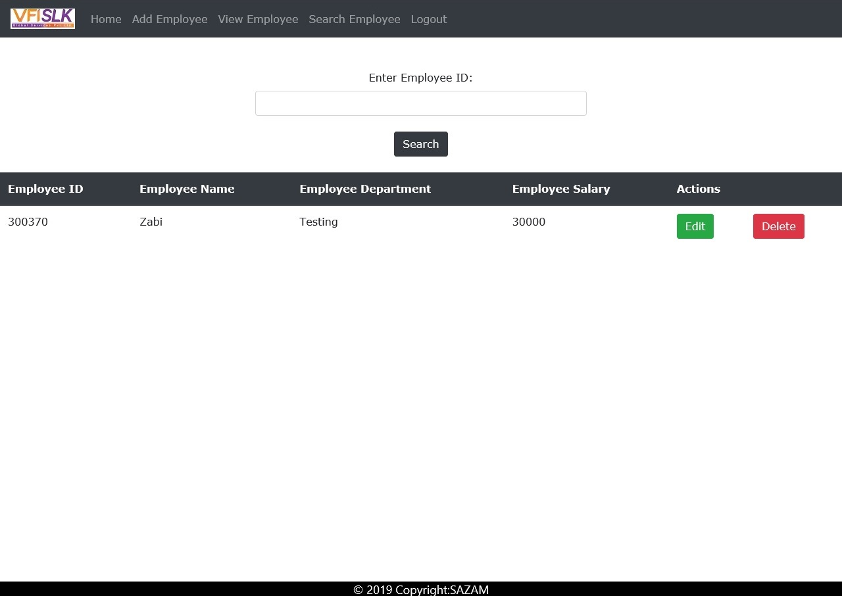
Search Employee

Slide 12
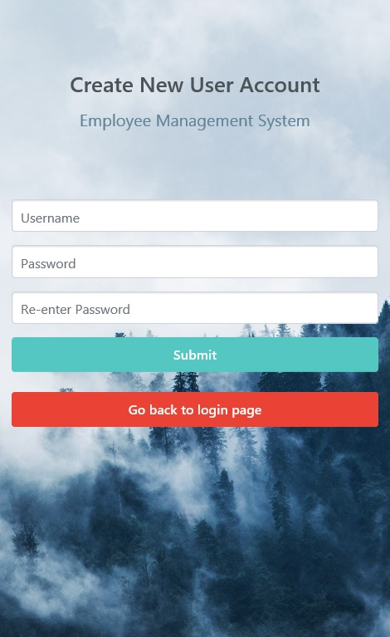
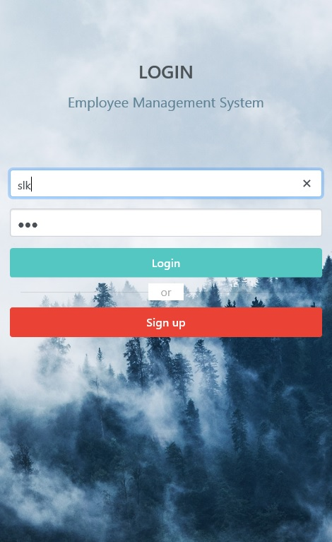
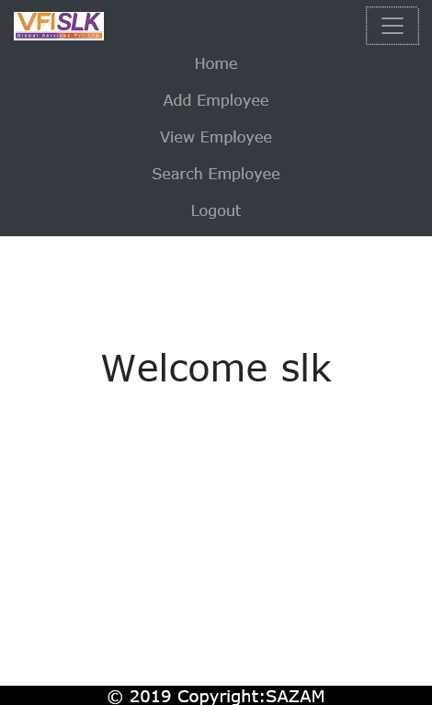
Mobile Friendly

Slide 13
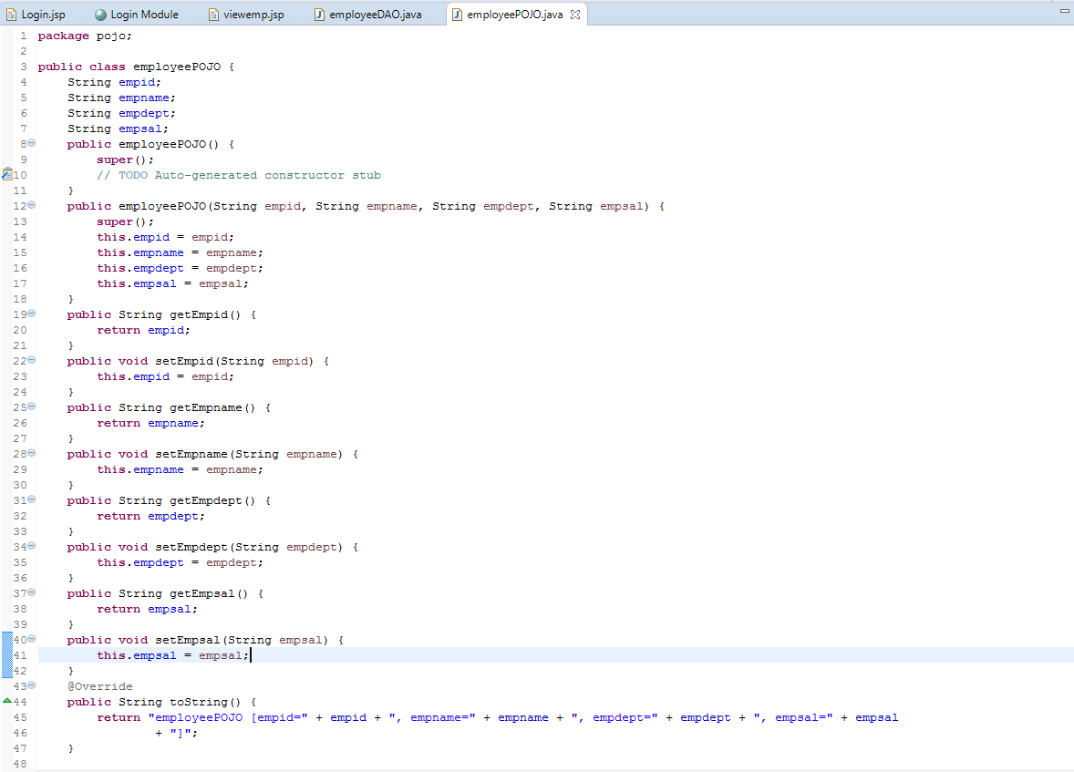
Sample Code- EmployeePOJO

Slide 14
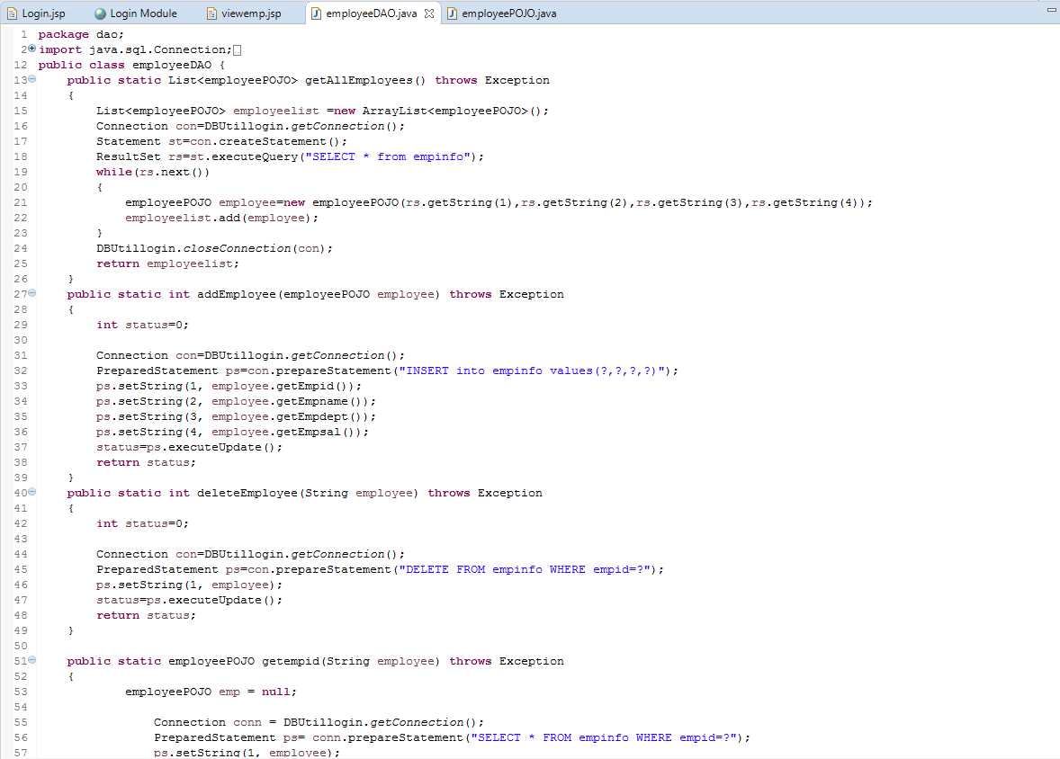
Sample Code- EmployeeDAO

Slide 15
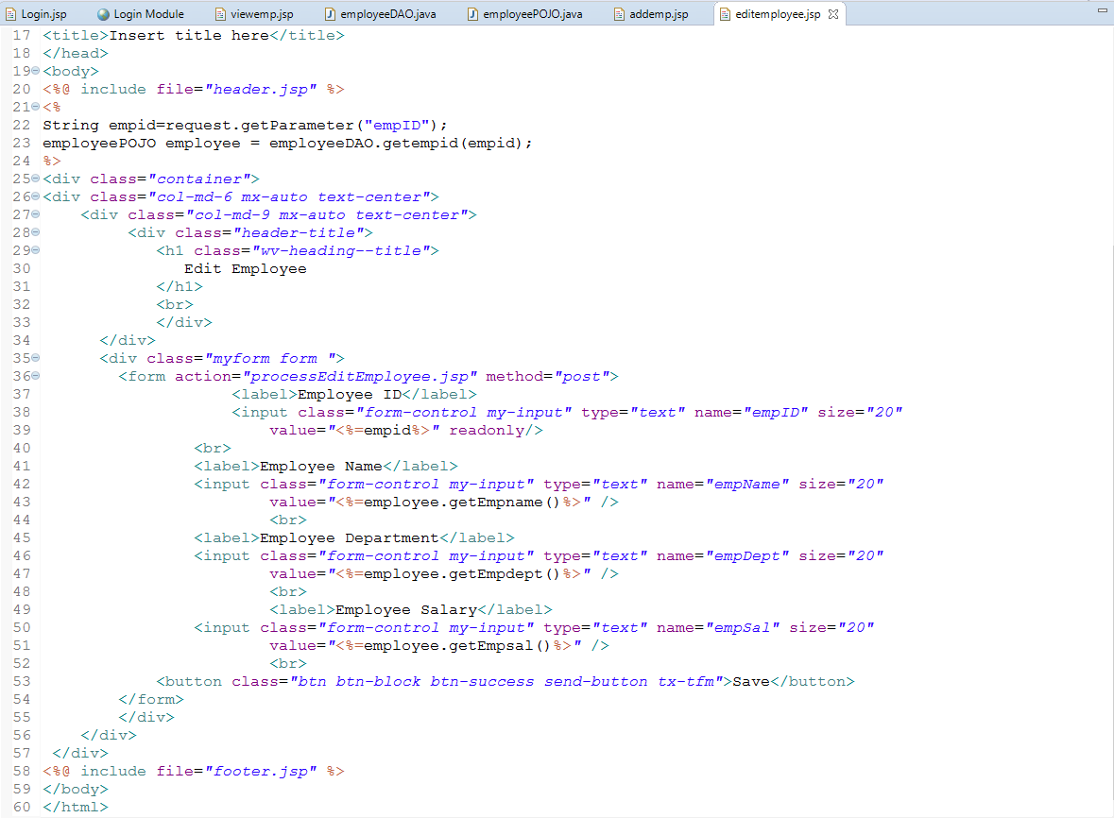
Sample Code- Edit Employee

Slide 16
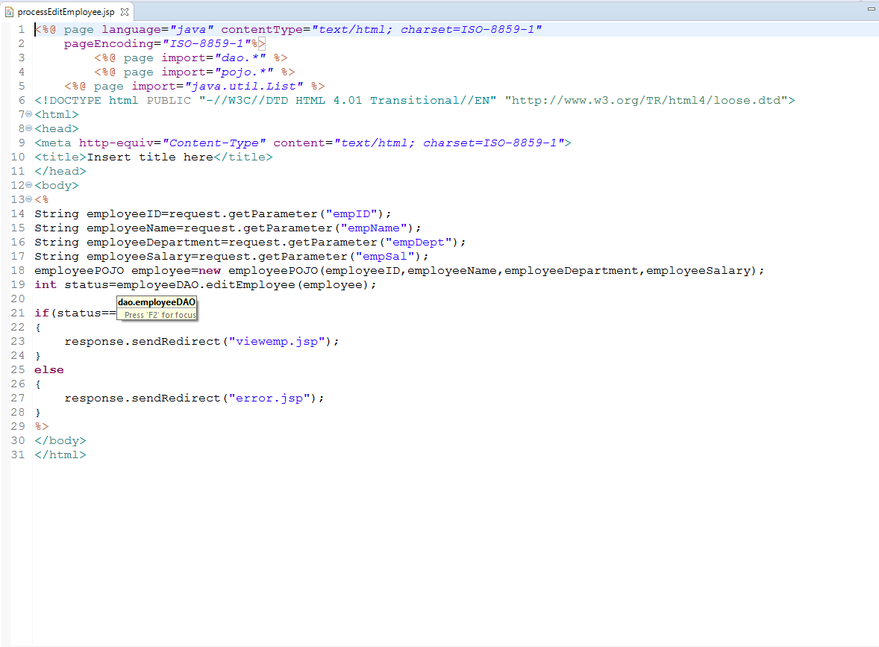
Sample Code- Edit Process

Slide 17
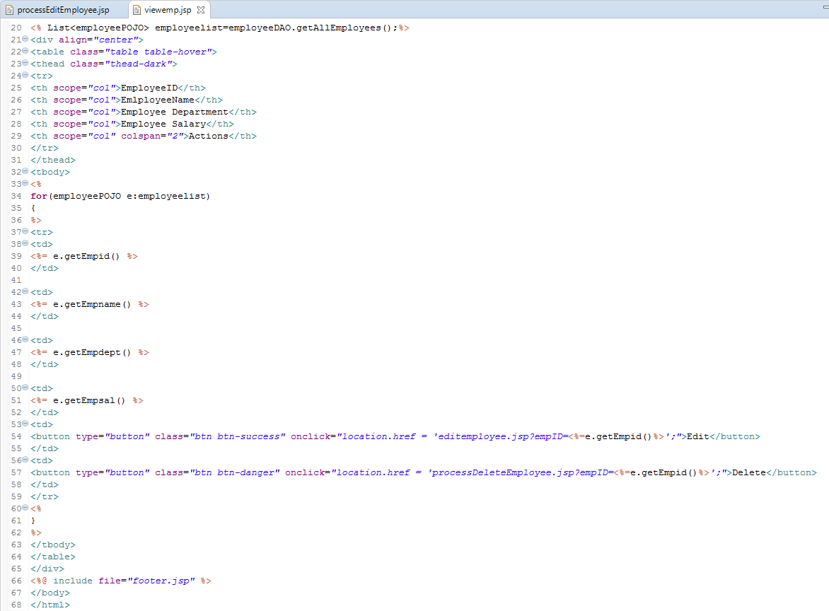
Sample Code- View Employee

Slide 18
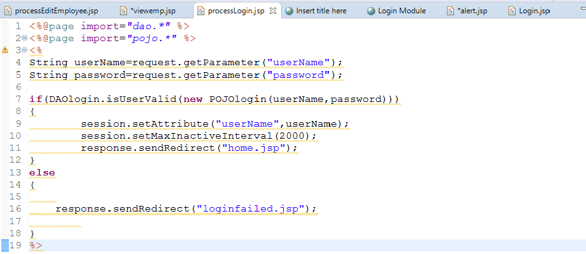
Sample Code- Session Management
Set Username as session attribute to maintain session

Slide 19
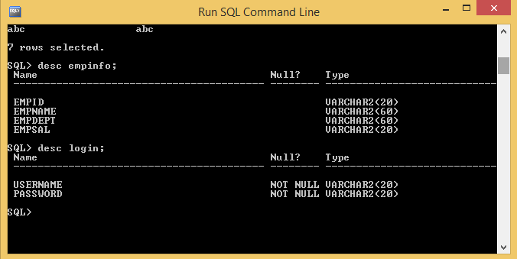
Sample Database

Slide 20
Source Code
https://github.com/akshaychavan97/Employee-Management-System
https://github.com/mayureshps/Employee-Management-System
https://github.com/ArpitaSarvi/Employee-Management-System
https://github.com/zabimd18/Employee-Management-System
https://github.com/SandeepNaik-174/Employee-Management-System

Slide 21
Thank You

